Slide 1


Slide 2

RATIONALE

Slide 3

The storage in a smart phone would cost
(in 2011 dollars)
$7,571 in 2001
$212,040 in 1991
$3,796,800 in 1981
$56,168,800 in 1971
$1,233,179,000 in 1961

Slide 4
The Explosion of Scientific Data
Because of the massive decline in the cost of data collection, storage, and analysis, the quantity of scientific data being collected is growing at an extraordinary pace
  New opportunities for analysis
  New methods are being applied
  Marked acceleration in the pace of discovery

Slide 5
The Big Challenges
The quantity of scientific data is exploding, but we lack basic infrastructure to maintain them or capitalize on opportunities for analysis and discovery
  Most scientific data is at risk of loss
  Most scientific data is inaccessible
  Metadata are usually incomplete and inadequate
  Little interoperability across datasets or data types
  Data are trapped in disciplinary silos

Slide 6
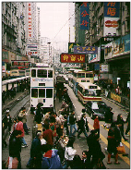
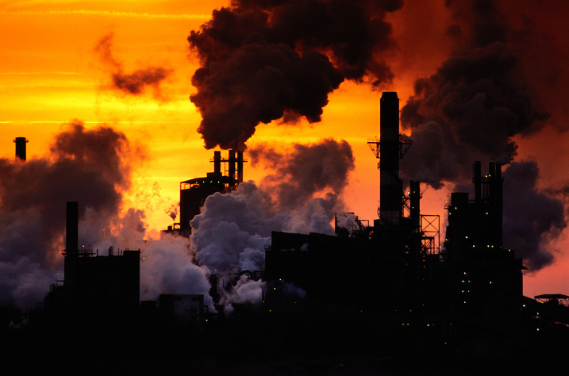
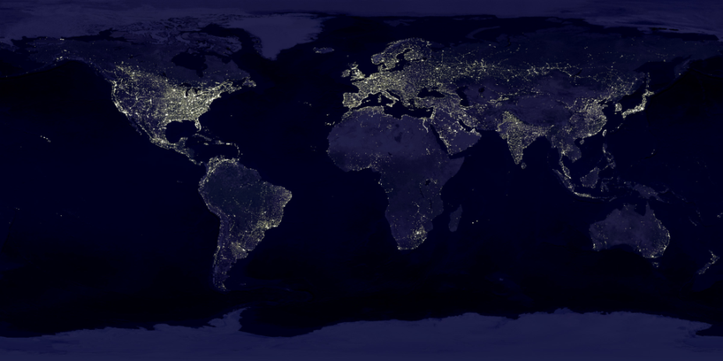
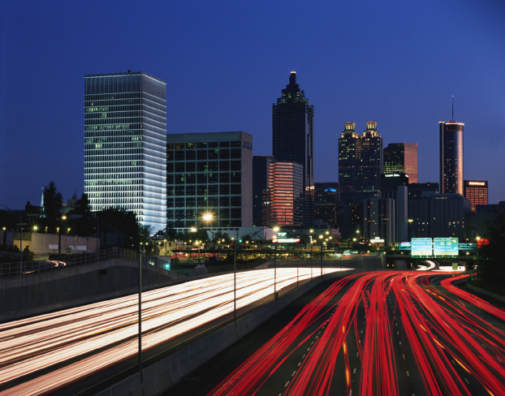
Why Population and Environment?
Massive Planetary Change between 1950 and 2000
Population
  population doubled
  economy grew seven-fold
Agriculture
  food consumption tripled
  water use tripled
Energy use
  fossil fuels increased four-fold

Slide 7
The Temporal Dimension
TerraPop

Slide 8
TerraPop Goals
Provide an organizational and technical framework to preserve, integrate, disseminate, and analyze global-scale spatiotemporal data describing population and the environment.

Slide 9
Primary Objective
Lower barriers to conducting interdisciplinary human-environment interactions research by making data with different formats from different scientific domains easily interoperable
  Population microdata
  Government land-use statistics
  Land cover data from satellite imagery
  Historical climate records (temperature, precipitation, cloud cover)

Slide 10






TerraPop Collaborating Organizations

Slide 11
Project Elements
  Archival Development
  Data Integration, Dissemination, and Analysis
  Education and Outreach
  Organizational Development

Slide 12
1. Archival Development
  Collect, integrate, describe, and preserve data describing changes in the world’s population and environment.

Slide 13

Data Collection:
Initial Population Data Sources
Population microdata from censuses
Focus on Brazil and Malawi

Slide 14
Age
Birthplace
Sex
Mother’s birthplace
Relationship
Race
Occupation
PopulationMicrodata
Structure
Geographic and housing
characteristics
Household record
(shaded) followed
by a person record
for each member
of the household
For each type of
record, columns
correspond to
specific variables

Slide 15
The Power of Microdata
Customized measures: Variables based on combined characteristics of family and household members, capitalizing on the hierarchical structure of the data
Multivariate analysis: Analyze many individual, household, and community characteristics simultaneously
Interoperability: Harmonize data across time and space
For each person, detailed information about geographic location, economic activities, educational attainment, literacy, fertility history, child mortality, migration, place of former residence, marital status, consensual unions, family composition, disabilities, water supply, sewage, building materials (floor, roof, etc.), and many other characteristics.
Age classification for school enrollment
in published U.S. Census

Slide 16
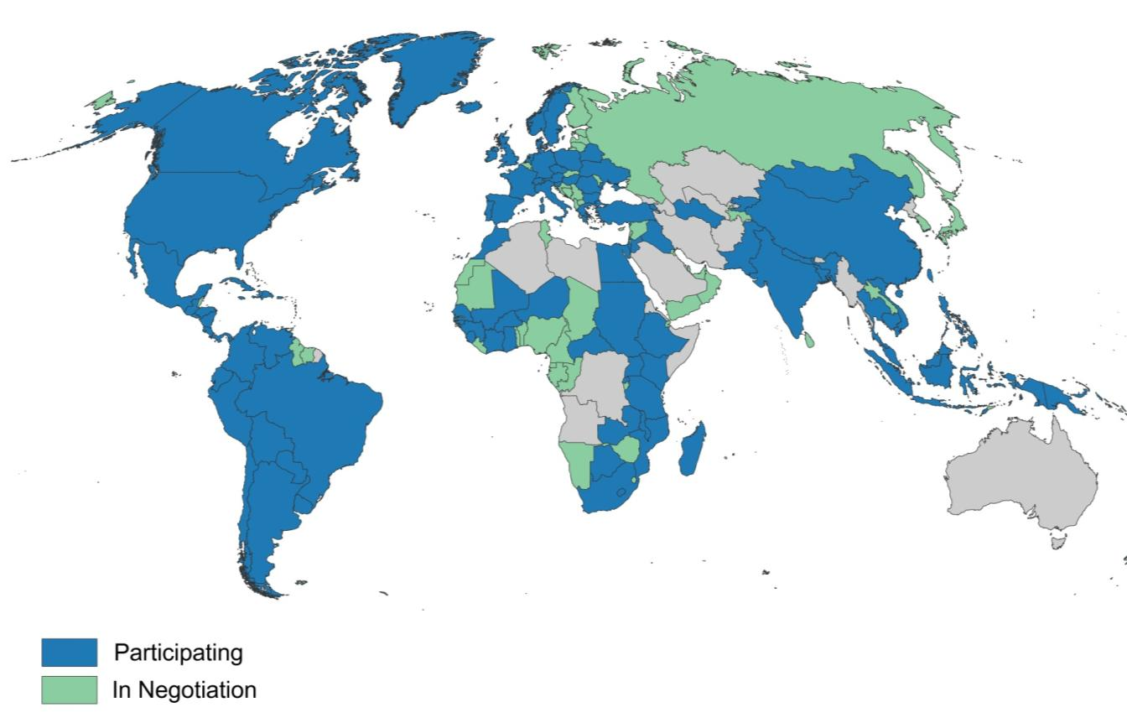
Participating Countries

Slide 17

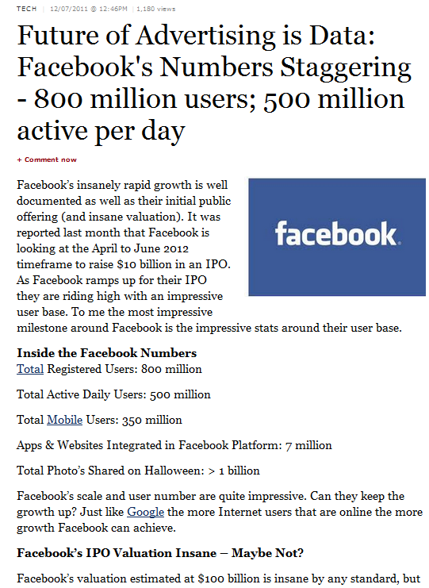
Facebook has data on 800 million people
We have data on
912 million people
USA |  | 165
International |  | 481
Historical |  | 266
Total |  | 912

Slide 18
Data Collection:
Initial Sources of Environmental Data
Land cover data from satellite images
(Global Land Cover 2000)
Land use data from satellites and government records (Global Landscapes Initiative)
Climate data from weather stations (WorldClim)

Slide 19
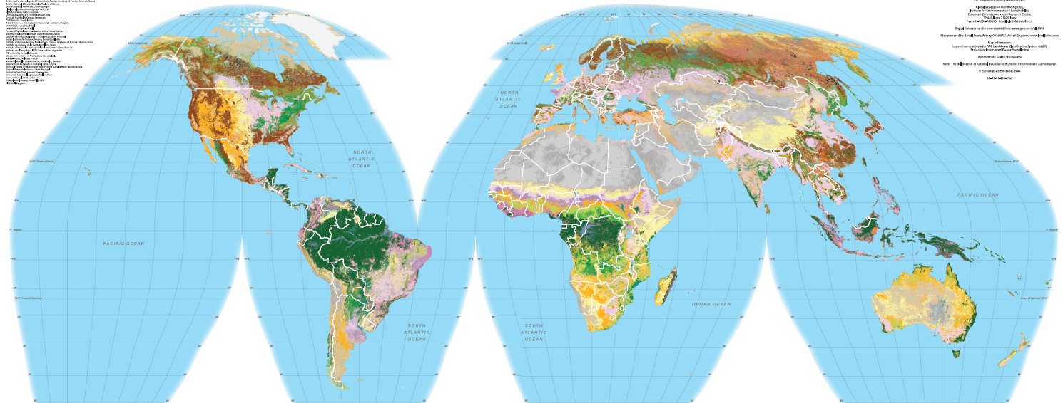
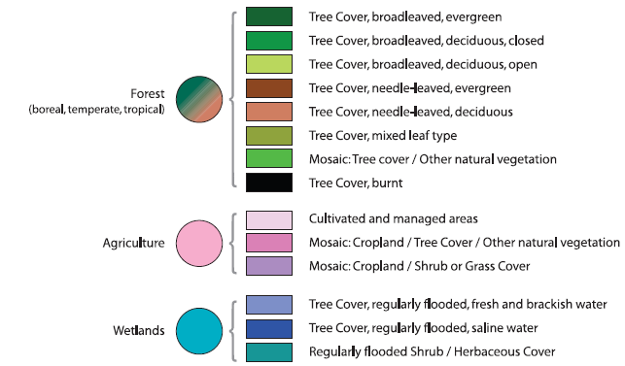
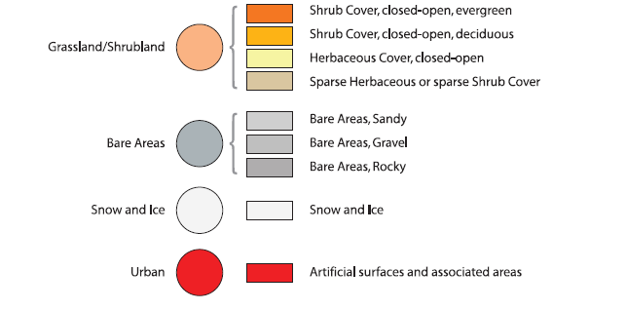




Land Cover Data
Global Land Cover 2000
Grid of 1 km sq cells
Cell values are dominant land cover
Derived from satellite images

Slide 20
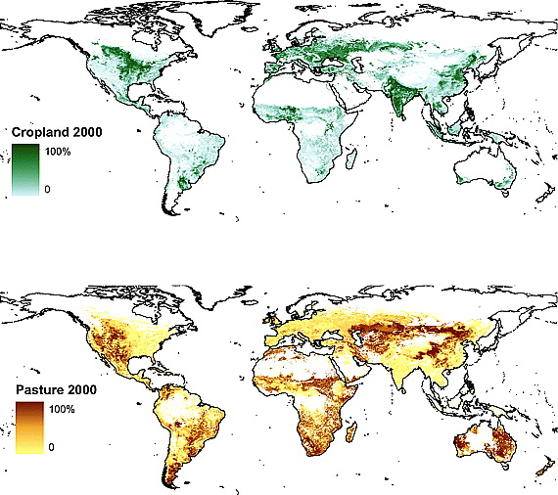
Land Use Data
Global Landscapes Initiative / Farming the World
Grid of 10 km cells
Values are % of cell used for given purpose
Derived from satellite and agricultural census data
Additional data sets for 175 specific crops and yields

Slide 21
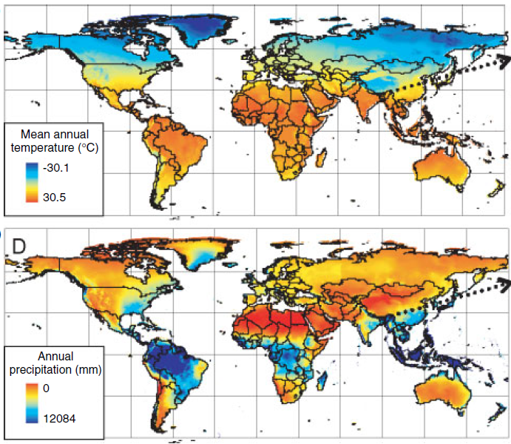
Climate Data
WorldClim
Grid of 1 km cells
Interpolated from climate station data
Incorporate data from 1950-2000

Slide 22
2. Integration, Dissemination, and Analysis
  Create tools and procedures to integrate, disseminate, and analyze population and environmental data.

Slide 23
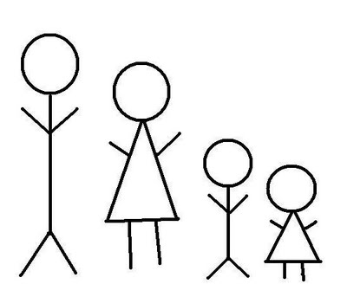
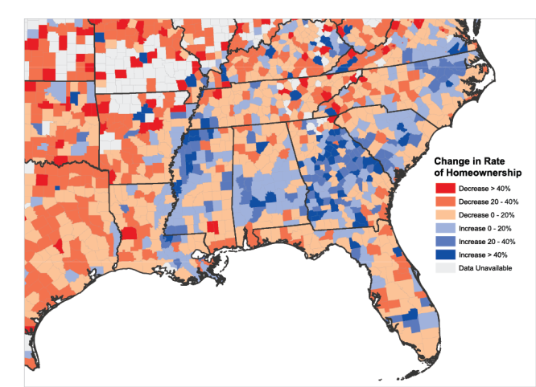
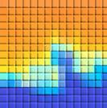
Three Source Data Formats
Microdata:
Characteristics of individuals and households
Area-level data: Characteristics of places defined by administrative boundaries
Raster data:
Values tied to spatial coordinates

Slide 24
Three Output Formats
Census microdata with attached characteristics describing land use, land cover, and climate for local areas
Aggregate data for administrative districts with tabulated population data and environmental characteristics
Gridded data with characteristics of population and environment

Slide 25
TerraPop Prototype Data Transformations
Input Formats
Output Formats
Microdata
Microdata
Areal data
Areal data
Raster data
Raster data

Slide 26
Analysis tool needed for microdata conversion
Input Formats
Output Formats
Microdata
Microdata
Areal data
Areal data
Raster data
Raster data

Slide 27
TerraPop Data Integration
Input Formats
Output Formats
Microdata
Microdata
with characteristics of surrounding area
Area-level
with summaries of microdata and raster data
Area-level data
Raster data
with gridded representations of microdata and area-level data
Raster data

Slide 28
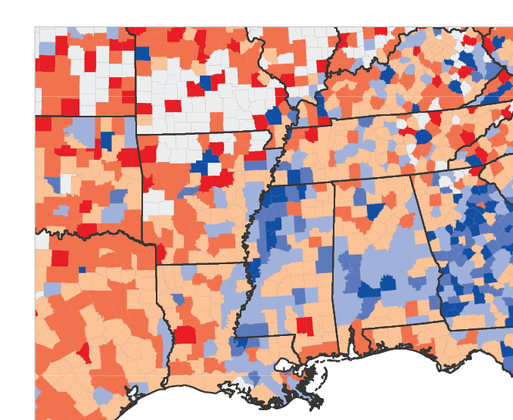
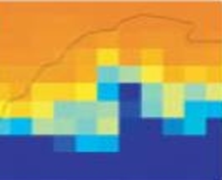

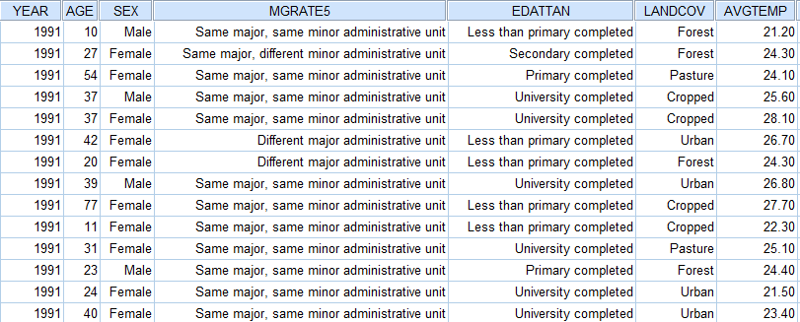
Integration – Microdata Output
Census microdata with attached characteristics describing land use, land cover, and climate for local areas
Individuals and households
with their environmental
and social context

Slide 29
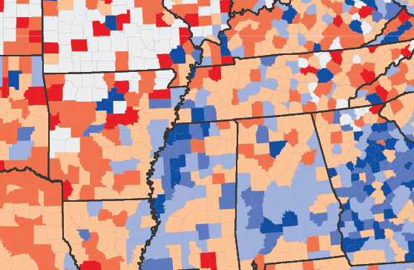
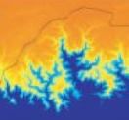

Integration – Area-Level Output
Aggregate data for administrative districts with tabulated population data and environmental characteristics
County ID | Mean Ann. Temp. | Max. Ann. Precip. | Rent, Rural | Rent, Urban | Own, Rural | Own, Urban | Vacant, Rural | Vacant, Urban
G17003100001 | 21.2 | 768 | 3129 | 1063 | 637 | 365 | 34 | 33
G17003100002 | 23.4 | 589 | 2949 | 1075 | 1469 | 717 | 0 | 0
G17003100003 | 24.3 | 867 | 3418 | 1589 | 1108 | 617 | 0 | 0
G17003100004 | 21.5 | 943 | 1882 | 425 | 202 | 142 | 123 | 0
G17003100005 | 24.1 | 867 | 2416 | 572 | 426 | 197 | 189 | 0
G17003100006 | 24.4 | 697 | 2560 | 934 | 950 | 563 | 220 | 14
G17003100007 | 25.6 | 701 | 2126 | 653 | 321 | 215 | 209 | 46

Slide 30
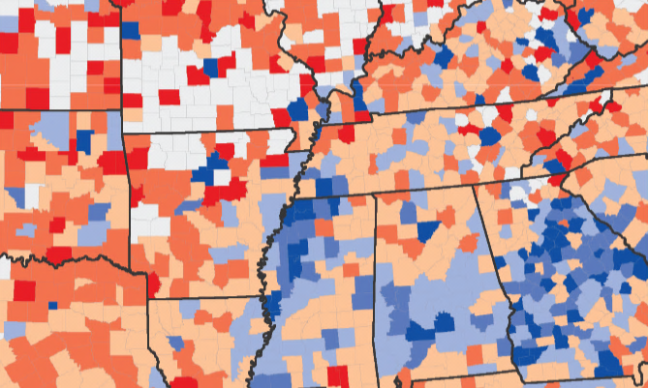
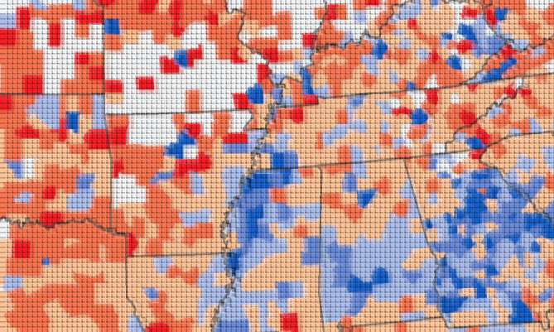
Integration – Raster Output
Gridded data with characteristics of population and environment
Raster format compatible with environmental models

Slide 31
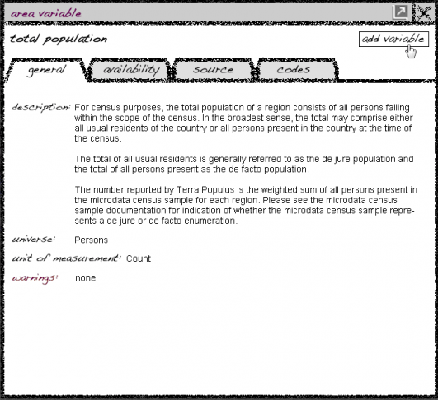
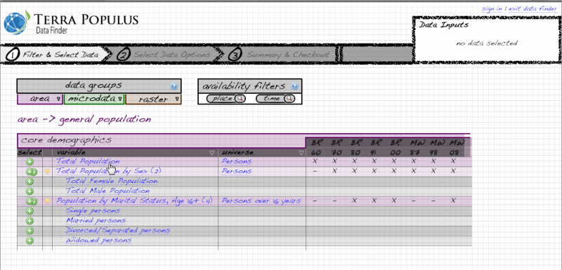
Data Access System
Browse and select variables

Slide 32
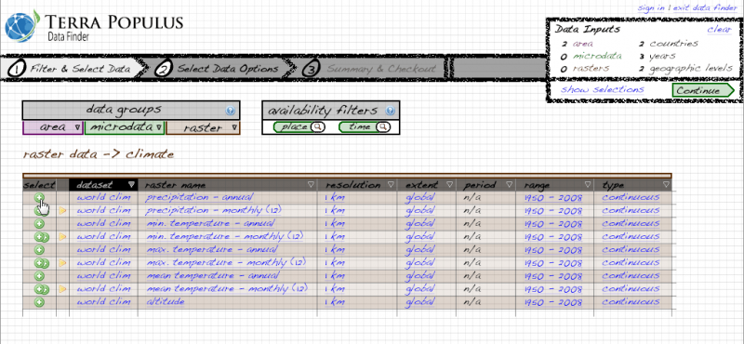
Data Access System
Browse and select variables

Slide 33
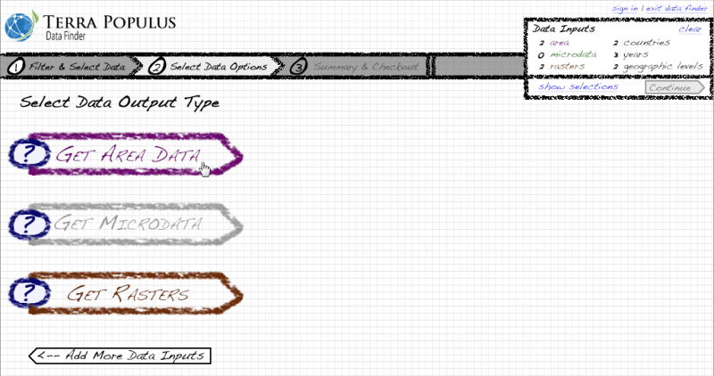
Data Access System
Choose output format

Slide 34
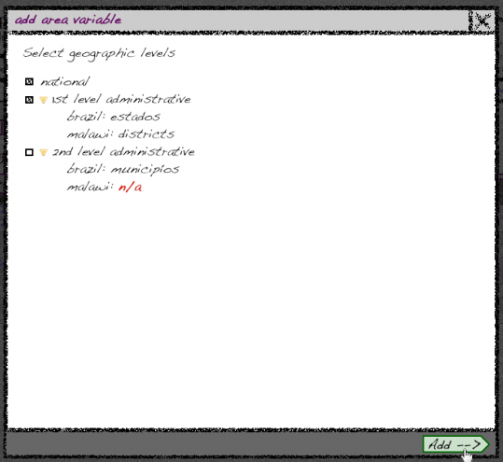
Data Access System
Choose output format

Slide 35
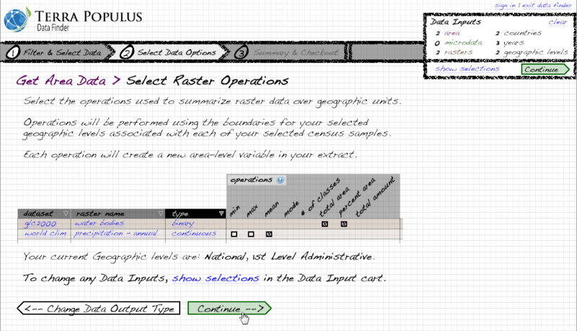
Data Access System
Select data transformation options

Slide 36
TerraPop Prototype
Data to be included
  Population microdata for Brazil (1960-2000) and Malawi (1998 & 2008)
  Aggregate population data at first and second administrative levels for Brazil and Malawi
  Land cover, agricultural land use, and climate data
Timeline
  Available for beta testing: May 2013
  Initial public version available by the end of 2013

Slide 37
3. Education and Outreach
  Engage the scientific community and the public

Slide 38
Education and Outreach for the Research Community
Curriculum of web-based training
Workshops at conferences
User support
Community tools to promote user engagement

Slide 39
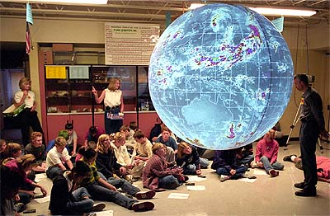
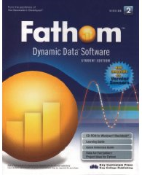
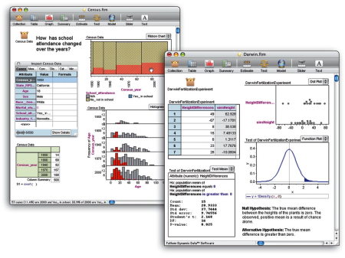
Public Education and Outreach
Partner with educational software developers
  Fathom
Integration with museum programs
  Science on a Sphere

Slide 40
4. Organizational Development
  Develop structures to ensure long-run financial and technical sustainability.

Slide 41
Sustainability
Create a sustainable organization that can guarantee preservation and access over multiple decades
  Organizational sustainability
  Financial sustainability
  Technological sustainability

Slide 42
agriculture
demography
transportation
Terra Populus
criminology
hazards
Population
Climate
Terra Populus
pollution
Land Use
Land Cover
health
economics
politics
bio-diversity
hydrology

